Slide 1
Generative AI

Slide 2
AI/ML Objectives
Operational Efficiencies
Increase Revenues
Deliver Enhanced Customer Experiences
Human level accuracy
Meaningful data from large datasets

Slide 3
Use-Cases
Underwriting, enable lenders to integrate more sophisticated modeling techniques and alternative data into lending decisions.
Fraud Detection, Anti-Money Laundering, KYC
Risk Simulations, HPC to run Monte Carlo Risk simulations
Algorithmic Trading
Drug Discovery - Generic drugs at less cost and time
Reduced fatalities, injuries etc.
Reduced Parking foot print, Shared autonomous vehicles.
Shortage of delivery services and drivers.

Slide 4
How AI Started / First UseCases
ML is model training from observed data
email spam filter using ML algorithms
Games like tic tac toe etc.
Early detection of diseases etc.

Slide 5
Jargon
Training
Testing
Matrix
DNN, GNN, CNN, RNN, Reinforcement Learning etc.
DL, AI, ML etc.
Features, Confidence Vector, Feature Extraction etc.
Statistics, Optimization, Linear Algebra etc.
Layer, fusing layers, pruning nodes etc.
Input node, output node, hidden layer etc.

Slide 6
What is AI
Uses statistic techniques to learn a model from observed data.
Inspired by Child Learning
A model is not ready to deploy with one iteration of training
Training / Iterating is time consuming where GPU are used.
Visualization
ML is Custom Algorithm
AI is Generic Algorithm

Slide 7
Q & A

Slide 8
Day 2
Supervised Learning
Unsupervised Learning
Linear Classification
What is Model
Predict Using Class Using model

Slide 9
Supervised Learning vs Unsupervised Learning
Supervised Learning | Unsupervised Learning
Learns from Labeled data. | Learns from Unlabeled data
Algorithm Trained on a dataset that includes input output pairs | Goal is to find hidden patterns or structure in data.
Generally used for classification and regression(where output is continuous value) | Commonly used for Clustering and dimensionality reduction(reducing the number of feature while retaining important information)
e.g., Linear Classification, Linear Regression, Logistic Regression, SVM, Decision Trees, Neural Networks(feed forward and CNN etc.) | K-Means, PCA, Autoencoders etc.

Slide 10
Classification
Regression
Clustering
Decision Trees
Dimensionality Reduction

Slide 11
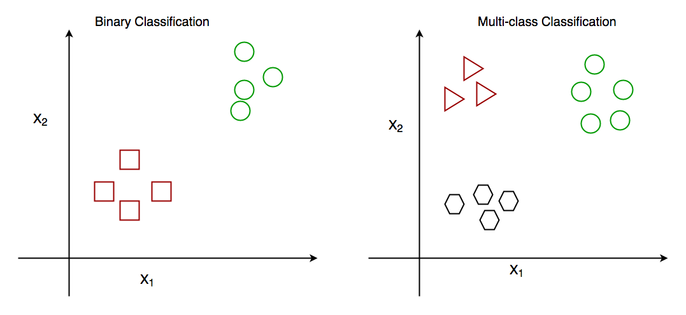
Linear Classification

Slide 12
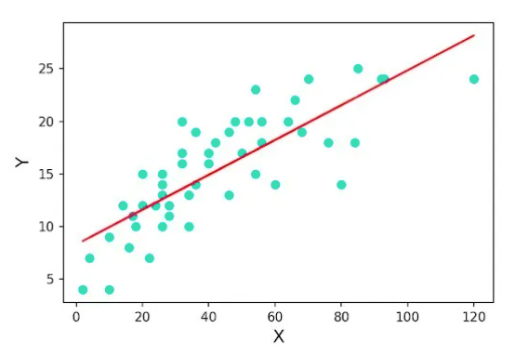
Linear Regression

Slide 13
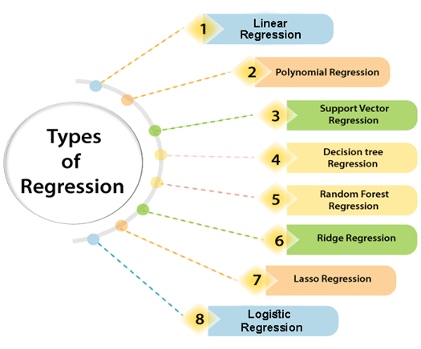
Types of Regression

Slide 14
Linear Classification Example Using Python
Dependencies
Python and Libraries as below
Pandas
Scikit-learn
Openpyxl etc.
Random Data Generation
Display Data
Train a Model
Predict
Accuracy Computation

Slide 15
Useful Links
Supervised Learning
Unsupervised Learning
Linear Classification
Loss Functions
Gradient Descent, Backpropagation, Artificial Neural Networks
Dropout, batch normalization, weight normalization, optimization
Image classification using Deep Learning
Reference https://github.com/snrazavi/Machine-Learning-in-Python-Workshop

Slide 16
Questions
How the model predict label for test data?
What are limitations of Linear Classifier?
What is a Feature?

Slide 17
Goal towards GNN (Gen AI)
Generate new content, images videos etc.
GPT Algorithm

